Slide 1
Partial Discharge Characterisation
Pulse Sequence Analysis
Thomas J. Smith & David Mahmoodi
ELEC6089 High Voltage Insulation Systems
Notes:
Hi, we are group 3, David Mahmoodi and Tom Smith. This presentation is about Partial Discharge characterisation by use of PSA

Slide 2
Presentation Agenda
Partial Discharge Background & Motivation
Characterisation Techniques
Partial Discharge Characterisation Tool
Results
Blind Test
Conclusions
Notes:
We will have a look into some backgrounds knowledge, available techniques, the tool we developed and the results. Then we will carry a blind test before the conclusion

Slide 3
Partial Discharge Definition
IEC 60270:
Localized electrical discharge that only partially bridges the insulation between conductors and which can or can not occur adjacent to a conductor.
F.H. Kreuger 1964
Electric discharges which do not bridge electrodes are called partial discharges.
Notes:
Partial discharge is defined as:
localised electric discharge which partially bridges the insulation.
Also as the electric discharge which do not bridge electrodes.

Slide 4
Motivation
PDs are a symptom of degradation
PDs are a stress mechanism themselves:
Particle impact stress
Thermal stress
Mechanical stress
Chemical stress
Electrical stress
Condition Based Maintenance – reliable and economical
Synergistic
interactions
I.J. Kemp: Advances in HV Engineering, Chapter 4: Partial Discharges and Their Measurement. The IET, Stevenage 2004
Notes:
So what are the motivations detecting PDs:
1. They are symptoms of degradation in HV equipment
2. Thy are sources of different kinds of stress on the protective dielectric as listed here
3. Detection of PDs help on doing condition based maintenance on equipment.
Partial discharges are both a symptom of degradation and a stress mechanism itself.
Degradation can occur due to electrical, mechanical, thermal or chemical/environmental conditions and is generally accompanied by PDs. Once PDs are present, these tend to dominate the stress degradation mechanism.
PDs produce electrons, ions, atoms, radicals and excited molecular species which respond to various forces such as thermal excitation, electric fields, electrostatic forces and the electric wind.
Particle impact stress: Gas discharge typically contains electrons, +ve and –ve ions and photons. These particles can impact on the surface, degrading the surface. These particles can be of sufficient energy to scission bonds, releasing further electrons. Generally, high energy electrons are required to cause substantial damage.
Thermal stress: energy injected by the PD can raise the temp of the material. Can be sufficient to damage polymeric material. Thermal stress alone is not likely to cause significant degradation, but can be contributory.
Mechanical stress: vibrational mechanical stress is setup in a solid insulating material subject to PD stressing under AC due to interactions of trapped charge in the solid matrix from the discharge interacting with the AC electric stress field. Trapped charge particles will be electrostatically repelled or attracted, also resulting in local mechanical stresses. Ions and free radicals from surface discharge can react with the solid to change mechanical properties, such as extra crosslinks in polymers reducing shear, tensile and compressive strength.
Chemical stress: already alluded to from other sections.
Electrical stress: superposition of electric fields due to charge deposition from PD results in local and microscopic degradation effects.
Synergism: These stresses are usually combined which causes issues.
Taking all these into account, it is clear why PDs should be monitored. Maintenance can be scheduled based on the condition of the dielectric based on the PD activity, rather than on time based schedules.

Slide 5
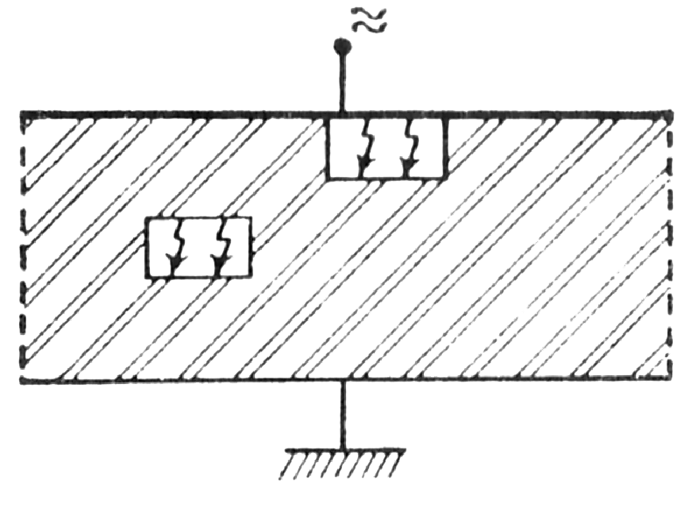
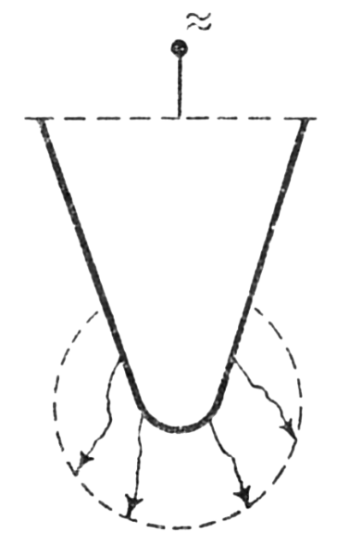
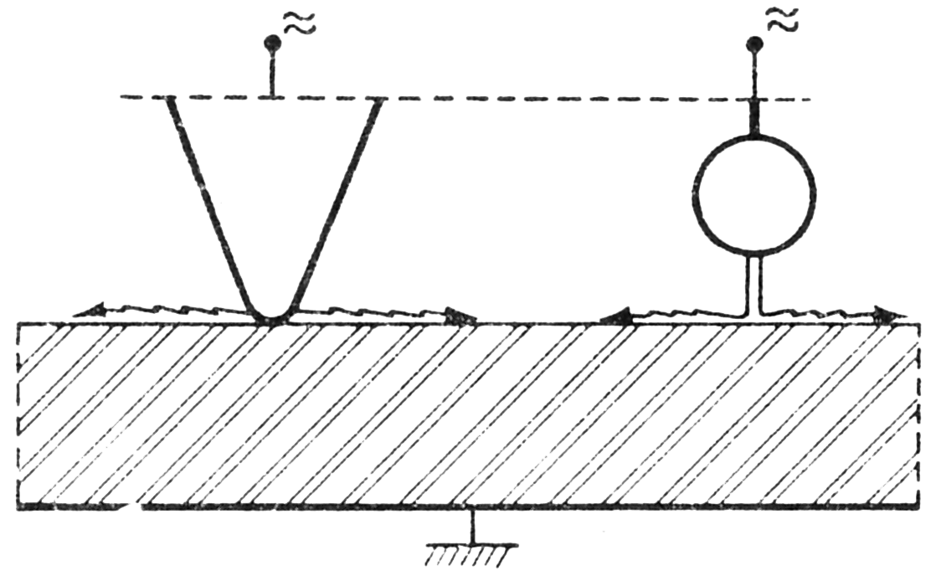
Classification
Void
Surface
Corona
Pictures Reprinted From: Frederik H. Kreuger: Discharge Detection in High Voltage Equipment. Heywood, London 1964
Notes:
Here is a general classification of PDs which we have a look at
Reference:
Frederik H. Kreuger: Discharge Detection in High Voltage Equipment. Heywood, London 1964
Ionisation – Any process by which an atom becomes electrically charged. Such as at the solution of salt in water, ionization by photons, etc.
Gas Discharges – The passage of current through gases by avalanches of electrons
All other processes involving ionisation
Partial Discharges – Gas discharges which do not bridge the electrodes
All other Gas Discharges
Internal Discharges – Void – Discharges occurring in inclusions or cavities in a dielectric.
Surface Discharge – Discharges occurring at the surface of a dielectric.
Corona Discharges – Discharges occurring in the strongly inhomogeneous field around a sharp point or edge of an electrode.
Note that it is wrong to use ionisation and PD synonymously – ionisation is much broader. Equally misleading is using PD and corona synonymously. Discharge should be used where a shorter version is required.

Slide 6
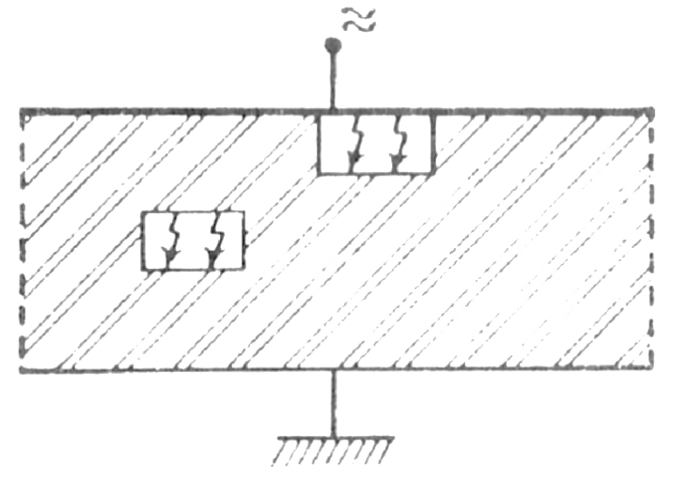
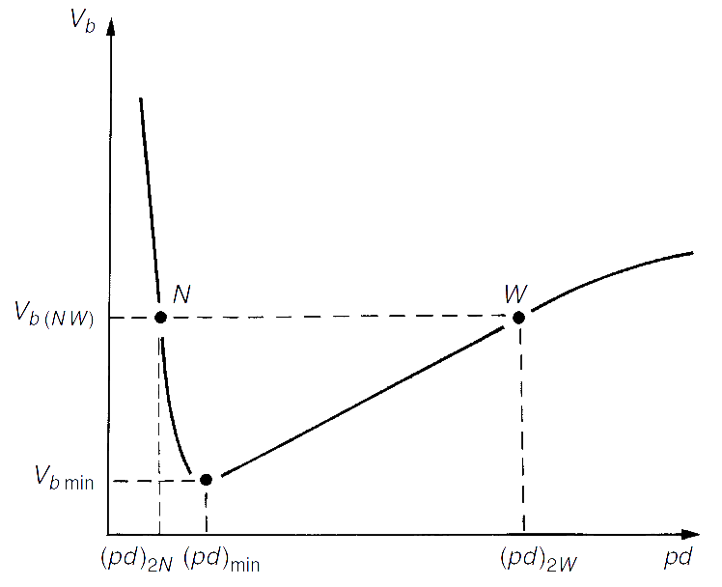
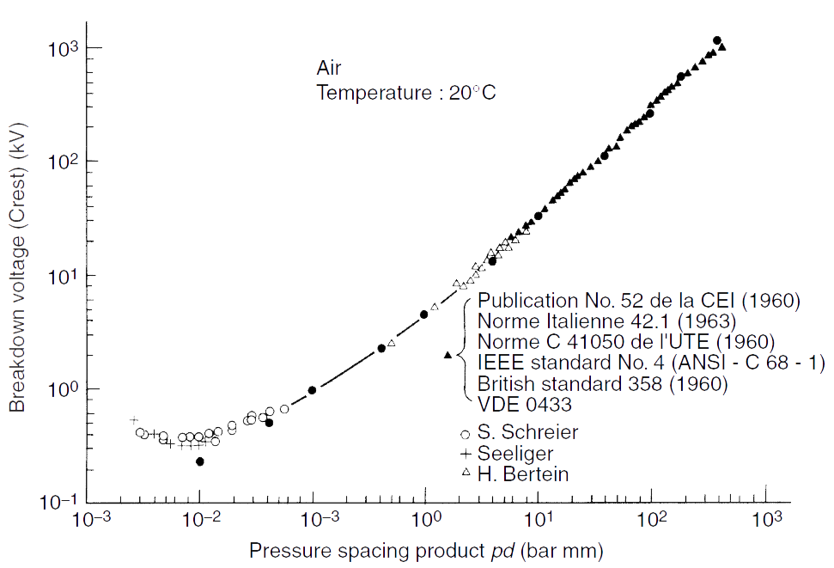
Classification - Void
Inclusions from manufacturing and defects
Inclusions of low dielectric strength
Breakdown reached sooner in the inclusion
Figure 1 Void discharge in a solid dielectric
Figure 2 Panchen's Curve for Air
Figure 1: Frederik H. Kreuger: Discharge Detection in High Voltage Equipment. Heywood, London 1964
Figure 2: E. Kuffel et al: High Voltage Engineering Fundamentals Newnes, Oxford 2000
Notes:
Voids are inclusions caused by defects of in manufacturing process.
They have lower strength than the dielectric so the breakdown than the dielectric.

Slide 7
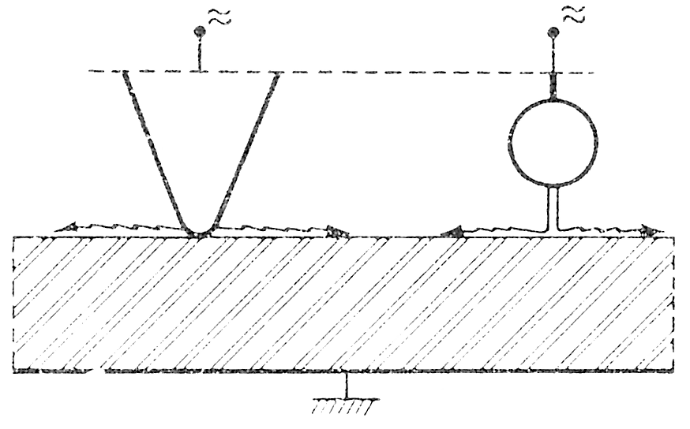
Classification - Surface
Stress component parallel to dielectric surface.
Bushings, cable ends, generator winding overhangs.
Electric field affected so the discharge extends further than the initial locality.
Figure 1 Surface discharge in a solid dielectric
Frederik H. Kreuger: Discharge Detection in High Voltage Equipment. Heywood, London 1964
Notes:
Anywhere that there is a stress parallel to the dielectric surface surface Partial discharge can happen
These are usually at bushings, cables and windings of HV.
In this case , the discharge can extend further than initially started region because each discharge effects the electric field.

Slide 8
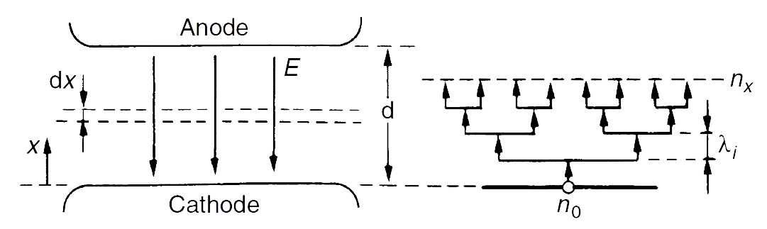
Classification - Corona
Sharp points or edges
Negative half cycle only
Townsend mechanism
Figure 1 Corona Discharge
Figure 2 Electron Multiplication in a Gap – Showing Electron Avalanche
Figure 1: Frederik H. Kreuger: Discharge Detection in High Voltage Equipment. Heywood, London 1964
Figure 2: E. Kuffel et al: High Voltage Engineering Fundamentals Newnes, Oxford 2000
Notes:
Coronas are where there is sharp edge in HV equipment or transmission. Usually the discharge happens in negative half of AC voltage and it follows the Townsend discharge mechanism.

Slide 9

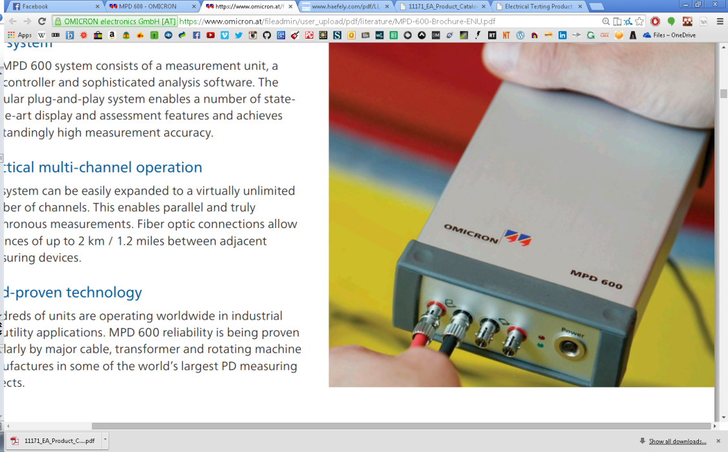
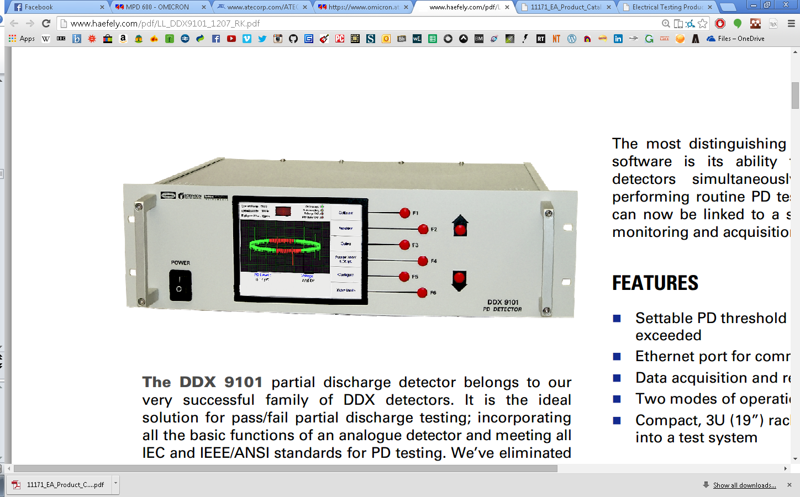
Detection
Thermal
Optical
Acoustic
Chemical
Pressure
Electrical
Frederik H. Kreuger: Discharge Detection in High Voltage Equipment. Heywood, London 1964
Notes:
Detection – the determination of the presence or the absence of partial discharges. Measurement comprises of determining the magnitude and determining location.
There are many detection methods possible, ranging from conventional to new techniques.
Optical – in translucent dielectrics internal discharges can be physically visible or electrically detected with photodiodes. Surface and corona discharges can also be detected by visual or photographic inspection.
Thermal – scanning by hand of a cable or bushing after over-voltage test is a well established empirical technique. Not very sensitive and the magnitude of discharges cannot be measured.
Acoustic tests range from simplistic aural tests. The hissing cable test has been well utilised. Equally, oil immersed microphones are often used in transformers and multiple nodes can be used to triangulate the discharge location in 3D space. Equally a contact microphone can be used on solid dielectrics to “listen” for the pressure impulse caused as the dielectric responds to the charge movement in an elastic manor.
Gas pressure is another well known test and changes occur due to the chemical reactions decreasing gas pressure when a discharge occurs.
Chemical methods are often used to detect the breakdown products or burned traces. This often takes place for transformer oil in condition based maintenance.
Electrical methods are the most well used and generally use RLC circuits to identify and then an amplifier to observe the data.
Top 2 – EA Instruments ultrasonic listening device one with remote listener
Mid – Omicron MPD600 electrical system which uses fibre optic transmission to reduce noise corruption. Variety of sensors can be used.
Bottom 1 – Haefely DDX9101 PD Detector – electrical detection system
Top 2 http://www.eatechnologyusa.com/product-catalog
Bottom 1 http://www.haefely.com/pdf/LL_DDX9101_1207_RK.pdf
Omicron https://www.omicron.at/fileadmin/user_upload/pdf/literature/MPD-600-Brochure-ENU.pdf

Slide 10
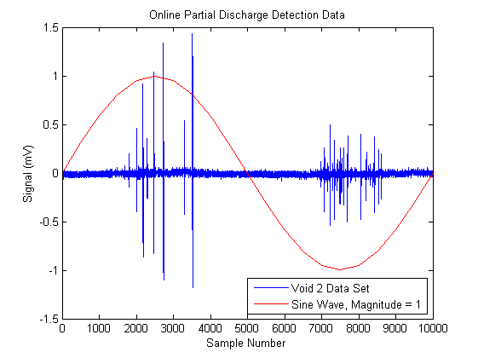
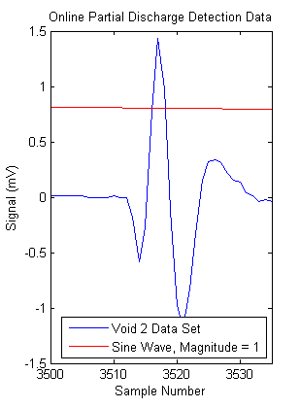
Online Readings
Notes:
So what is the data that come out of a PD detector circuit? Data supplied is from a Digital Storage Oscilloscope. We don’t know the actual detection setup, but we can make an assumption that it is some kind of electrical detection method.
The left figure shows one 50Hz cycle of the test data for the corona 1 data set. A large amount of measurement noise can be seen around zero due to high sensitivity of PD detection equipment, and susceptibility to radio interference etc. Corona occurs only in the negative half cycle due to the Townsend breakdown mechanism, which is what we can see in the picture.
The right figure focusses on a single pulse in that section. We can see a first peak, then a drop, then a second peak. This whole sequence is the current pulse due to a single PD event. Why does this current pulse occur?

Slide 11
Characterisation Techniques
Notes:
So, now about characterization techniques.

Slide 12
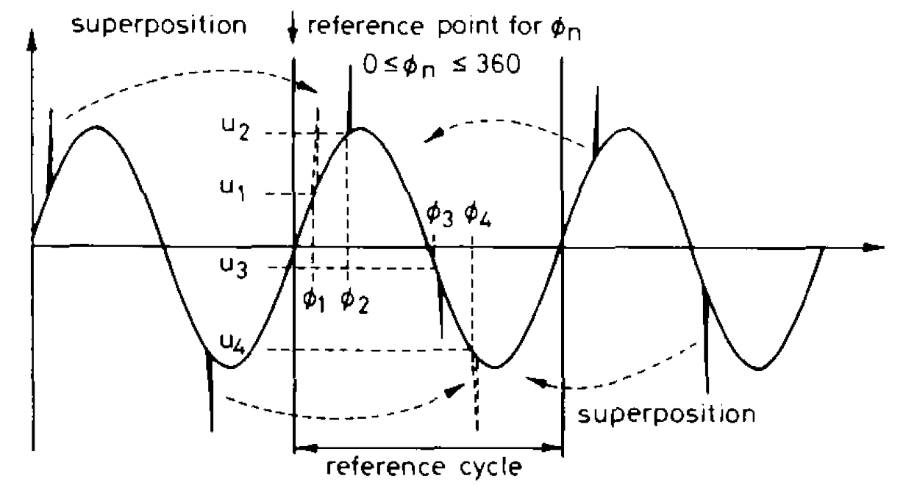
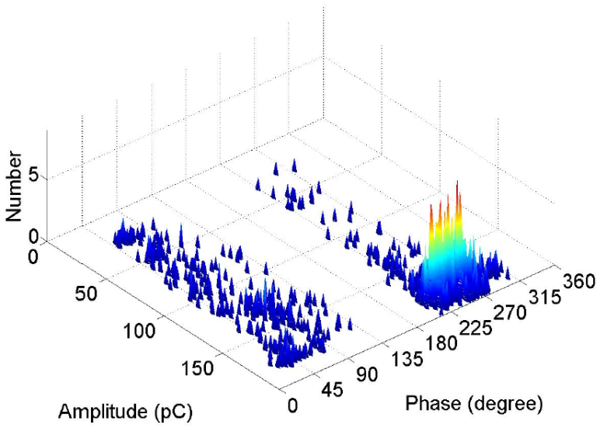
Phase Resolved PD Analysis
Mean, variance, skewness, kurtosis and other statistical tools can be utilised to gain further insight.
Transform data to a single reference cycle and lose sequence information.
Implicit assumption of independence.
Phase-Magnitude-Number (Φ-q-n)
Advantages: Mean, variance, skewness, kurtosis and other statistical information
Disadvantages: Transform data to a single reference cycle and lose sequence information
Hoof, M., and R. Patsch. "Pulse-sequence analysis: a new method for investigating the physics of PD-induced ageing." IEE Proceedings-Science, Measurement and Technology 142.1 (1995): 95-101.
Notes:
In PRPD, the phase, charge and number of discharges are measured and analysed. In terms of benefit, it will show many statistical characterisation of the PD. But on the downside it loses the PDs sequence information because of using a single reference cycle to analysing data
First step is to transform all gathered data into a single reference cycle.
No correlation between pulses in the same or different cycle are considered.
Secondary statistical data can be calculated which can reveal more information.
However the sequence information is lost during the transform.
It remains possible to identify and classify PDs using this type of analysis.

Slide 13
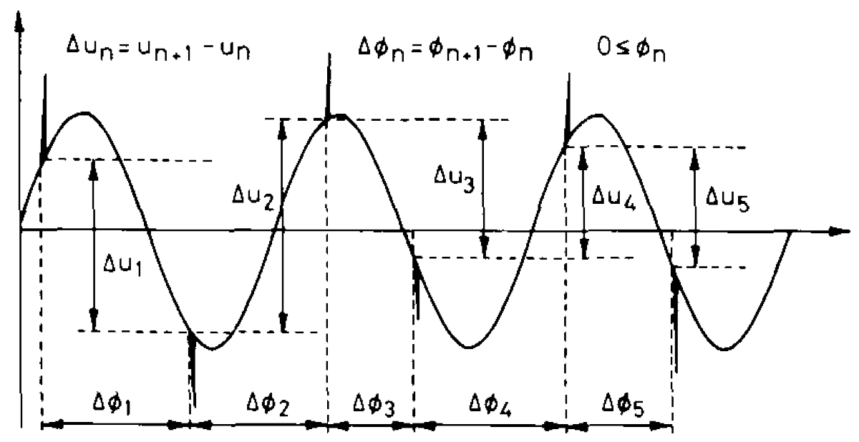
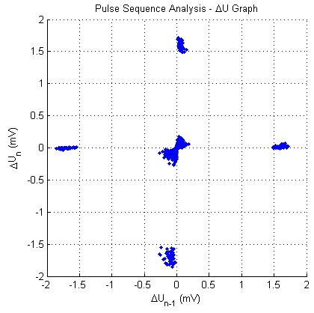
Pulse Sequence Analysis
Utilises sequence information so that remaining charge accumulation is accounted for. Assumes dependence between discharge events.
Statistical techniques unavailable.
Advantages: Utilises sequence information so that remaining charge accumulation is accounted for. Assumes dependence between discharge events.
Disadvantages: Statistical techniques unavailable
PSA – from Hoof, M., and R. Patsch.
I.J. Kemp: Advances in HV Engineering, Chapter 4: Partial Discharges and Their Measurement. The IET, Stevenage 2004
Notes:
The left over charge or space charge in each PD will affect the next PD time and size. This shows a big difference between different sources of PD and could be used as a better tool to characterise PD and their sources. Nevertheless the down side here is the loss of statistical information and techniques
Hoof, M., and R. Patsch. "Pulse-sequence analysis: a new method for investigating the physics of PD-induced ageing." IEE Proceedings-Science, Measurement and Technology 142.1 (1995): 95-101.
Void discharge – from our program.

Slide 14
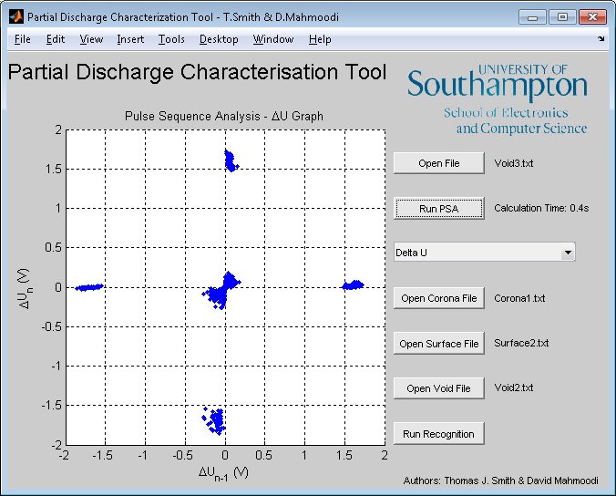
Partial Discharge Characterisation Tool
MATLAB Programming

Slide 15
Functional Description
Acquisition
Read in text data
Generate time stamping
PSA
Perform PSA arithmetic
Generate Graphs for Analysis
Preprocessing
Denoise data
Filter for PD peaks
Automated Characterization
Feature extraction by neural networks
Euclidian distance computation
Notes:
The acquisition phase is fairly mundane. We simply read in all of the text data, of which there are 500,002 items in each set. We then linearly discretise the space between 0 and 1 to find the respective time of the sample and produce the incident sine wave from which we take U.

Slide 16
Preprocessing – Noise Removal
Wavelet Signal Decomposition
Apply thresholds according to noise level
Reconstruction of noiseless signal using data that passes thresholding
Wavelet packet denoising algorithm:
No a priori data or assumptions required
Able to remove noise with minimal distortion
Superior to other DSP techniques
Kyprianou, A., et al. "Wavelet packet denoising for online partial discharge detection in cables and its application to experimental field results."Measurement Science and Technology 17.9 (2006): 2367.
Notes:
This method assumes there is no a priori information about the characteristics of the PD, such as bandwidth or origin of occurrence.
Wavelet research started in 1900s and has only recently started to be applied to PD analysis (2000s).
Common structure to multi-resolution wavelet analyses. Decompose to a set of dilated and scaled versions of the mother wavelet. Threshold applied to the resulting wavelet coefficient. Then reconstructed using the coefficients that survive thresholding. The reconstructed signal is then an estimation of the original without the noise.
Other techniques such as FIR filtering or Fourier analysis cannot produce adequate denoising without significantly distorting the PD peaks. Hence wavelet analysis is required.

Slide 17
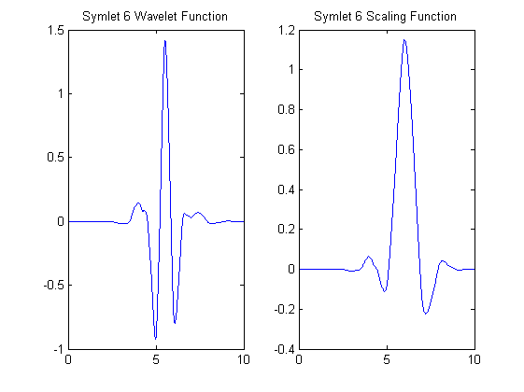
Noise Removal – Wavelet Selection
Symlet 6 Wavelet Selected
Kyprianou, A., et al. "Wavelet packet denoising for online partial discharge detection in cables and its application to experimental field results."Measurement Science and Technology 17.9 (2006): 2367.
Notes:
Symlet 6 chosen according to Lewin’s paper. Largest number of vanishing moments for a minimum support. This means that in the presence of a PD pulse, for a certain scale and translation, there is a high degree of correlation between the signal and the wavelet or its scaling function. This yields fewer results and higher wavelet coefficients which in turn means the Symlet family adapt better to the high-frequency bandwidth of a PD signal. Other papers use Symlet 8 such as here https://secure.ecs.soton.ac.uk/notes/comp3020/e_archive/COMP3020/0809/jh306/pdfs/Report.pdf but the principle is very much the same. The wavelet can be seen as a more spikey function when compared with a sine wave used in Fourier analysis, and is hence more well suited to analysing spiky data.

Slide 18
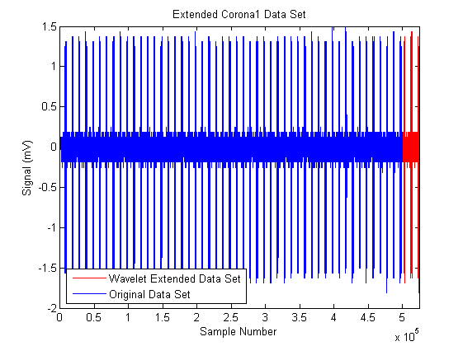
Noise Removal – Signal Extension
Symmetric signal extension
Notes:
Pretty simple to gloss over. Power of two required for wavelet decomposition. Could truncate but chose to extend, filter then truncate to preserve maximum information.

Slide 19
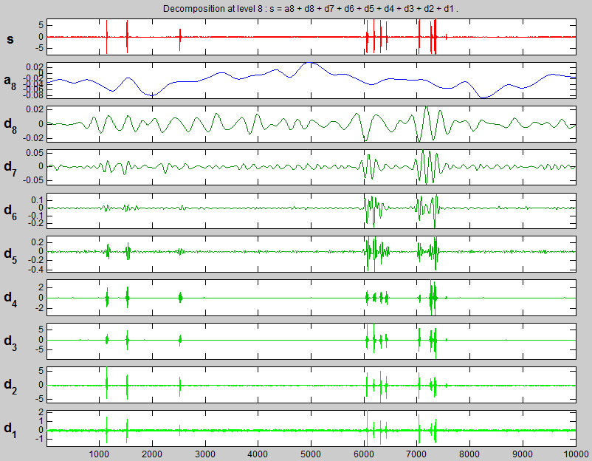
Noise Removal - Decomposition
Notes:
Wavelet decomposition transforms the time domain signal into the time-scale domain.
Each level of decomposition is fed through a series of hi-pass filters to down-sample by a factor of two. This generates higher frequency coefficients representing the detail of the signal. The signal is also passed through a lo-pass filter to down-sample by two to generate low frequency coefficients which represent an approximation of the original signal.
Generated using wavemenu in MATLAB

Slide 20
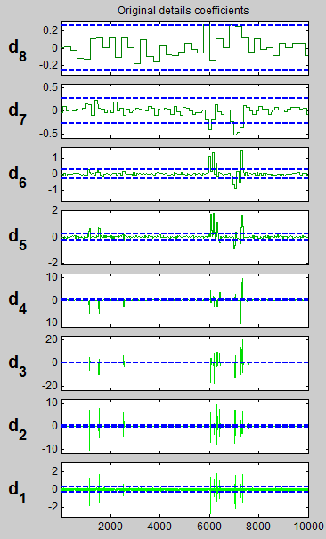
Noise Removal - Thresholding
Notes:
White noise energy is spread evenly throughout the coefficients of the wavelet decomposition. This means that large coefficients in either scale or translation are where the signal energy is concentrated. Hence we can determine a set of threshold coefficients to ignore the evenly spread noise energy. Hard thresholding has been used according to the paper. Hard thresholding removes all coefficients less than the threshold level. The threshold is determined from the standard deviation of the noise estimate in each level of decomposition. Figure from wavemenu function in MATLAB.
Kyprianou, A., et al. "Wavelet packet denoising for online partial discharge detection in cables and its application to experimental field results."Measurement Science and Technology 17.9 (2006): 2367.

Slide 21
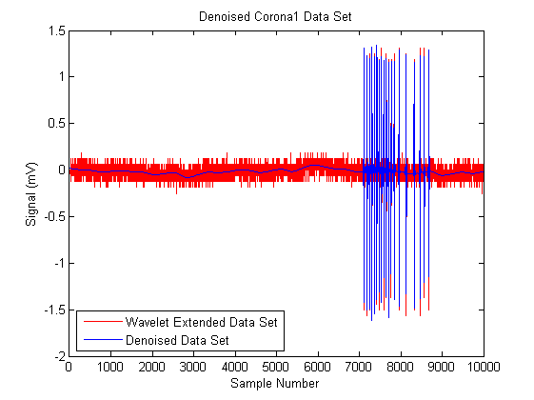
Noise Removal - Reconstruction
Notes:
The signal is then recomposed using only the wavelet coefficients that pass the thresholding. Thus the best estimate of the noise-free signal is generated with minimum distortion to the PD signals.

Slide 22
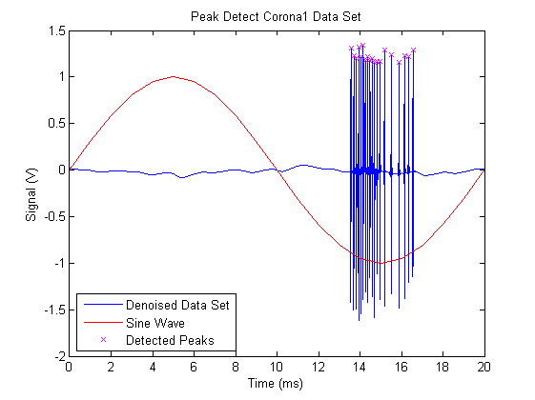
Preprocessing - Peak Detection
Notes:
The peaks of each PD event is then found using a matlab function.

Slide 23
Pulse Sequence Analysis
Uses the peaks found in filtered signal to find U_{n} and T_{n}
2D plots available
ΔU_{n} by ΔU_{n-1}
ΔT_{n} by ΔT_{n-1}
ΔU_{n}/ΔT_{n} by ΔU_{n-1}/ΔT_{n-1}
Filtered online signal
Notes:
The program uses the peaks to find the values of U_{n} and T_{n} . Then this data is used to plot 2D graphs which show these relationships of the PDs

Slide 24
Automated Characterization
Optional
Optional
Select 3 reference samples, one of each type; corona, surface and void
Reduce each sample to 20 cluster features through a competitive neural network
Compare Euclidean distance from each feature to unknown sample.
Select 3 reference samples; one of each type for comparison
Reduce the three reference and one unknown samples to twenty representative clusters
corona
surface
void
Compare Euclidean distance of the unknown sample features to each of reference sample features
Using dU/dT graph due to distinct features
Competitive Neural Network used for feature extraction
Shortest distance indicates class
Notes:
Characterization is optional and does not need to be run everytime. However the methodology we have used is shown above.
Since there is a different number of points in each graph type, we cannot directly compare them. Hence the neural network is used to extract the features of each graph.
We then compare the eucledian distance between each reference feature set and the lowest total distance indicates the closest similarity between extracted features.

Slide 25
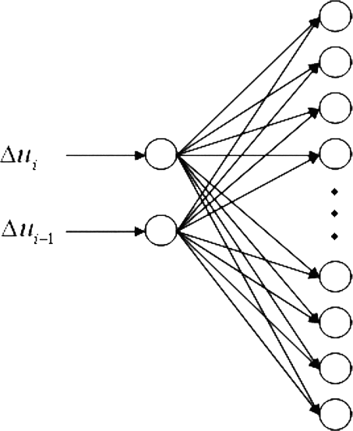
Competitive Neural Network
Neurons compete to ‘win’ each ΔU_{n} ΔU_{n-1} coordinate input.
Winning neuron adjusts weight vector to be closer to the input.
After training, the locations of the 20 weight vectors represent the cluster pattern of the original data set.
Mirzaei, Hasan Reza, et al. "New attempts in automated partial discharge identification using pulse sequence analysis." Properties and Applications of Dielectric Materials, 2009. ICPADM 2009. IEEE 9th International Conference on the. IEEE, 2009.
Notes:
This illustrates how a competitive neural network operates. However it is not necessary to have a full understanding of how it operates to understand our program.

Slide 26
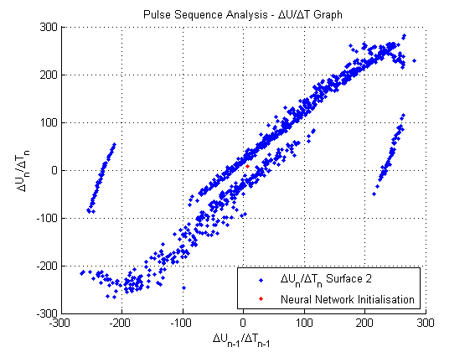
Initial Network Layout
Notes:
Initial network layout – see red dot in the centre which is the current 20 features. The blue is the surface 2 dU/dT graph which we are trying to reduce.

Slide 27
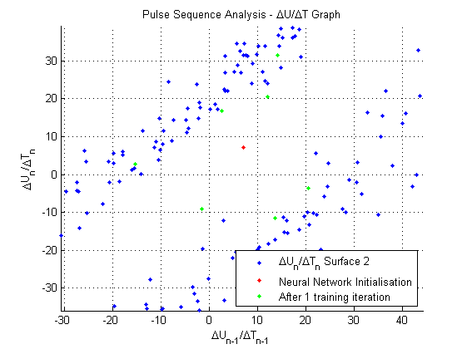
Extracted Features – Training 1
Notes:
After 1 training cycle the red dots have moved to the green dots becoming more representative of the graph

Slide 28
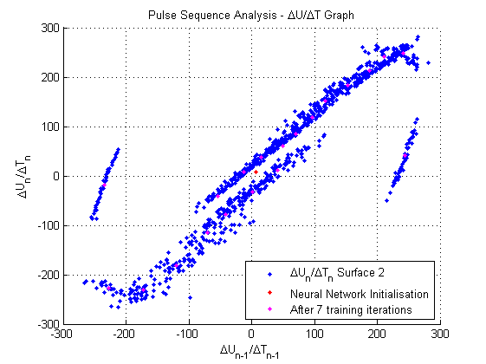
Extracted Features – Training 7
Notes:
After 7 training iterations, the purple dots pretty much replicate the important features of the blue graph.

Slide 29
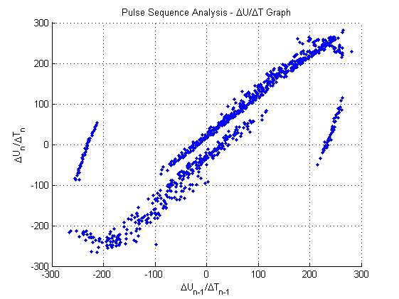
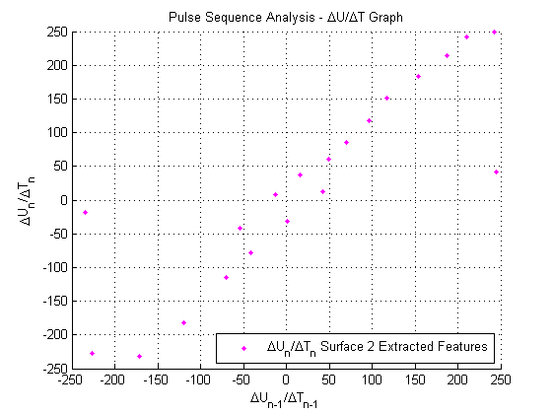
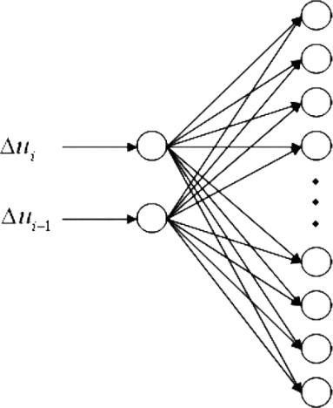
Neural Network Summary
Competitive
Neural Network
Notes:
So essentially for the purposes of this presentation, we can consider the neural network as a black box reducing an n-point dU/dT graph to 20 representative features we can use for comparison. Neural networks are discussed in more detail here:
Mirzaei, Hasan Reza, et al. "New attempts in automated partial discharge identification using pulse sequence analysis." Properties and Applications of Dielectric Materials, 2009. ICPADM 2009. IEEE 9th International Conference on the. IEEE, 2009.
http://www.mathworks.co.uk/help/nnet/examples/competitive-learning.html

Slide 30

Calculate Euclidian Distance
$d= \sum_{j=1}^{20}{\sqrt{{(w_{x}^{}−x)}^{2}+{(w_{y}^{}−y)}^{2} }}$ $1≤j≤20$
Compare unknown features with each of the three reference feature sets
Order is lost in Neural Network
Compute all possibilities
Select shortest vector and sum
Lowest total distance indicates high similarity between features – likely class
Notes:
Slides say it all.

Slide 31
Program testing
Notes:
We have a look at some test results

Slide 32
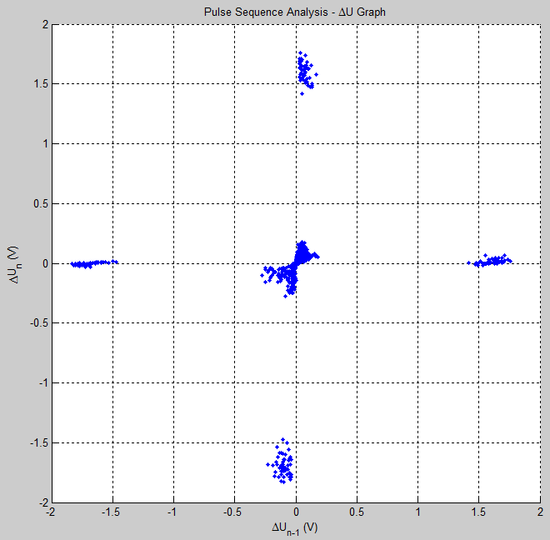
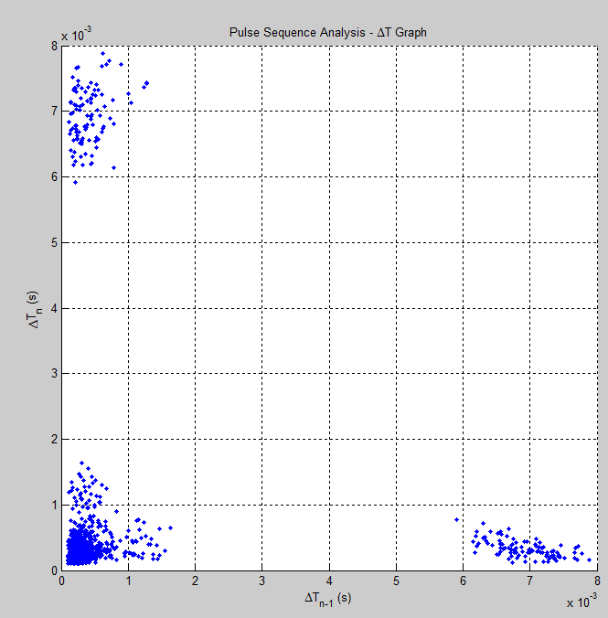
Void Detection
Notes:
As its expected for void, the voltage level difference between PDs are either too close to each other or are in opposite cycles

Slide 33
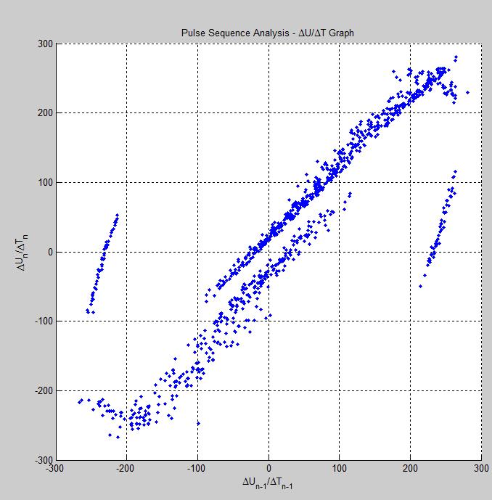
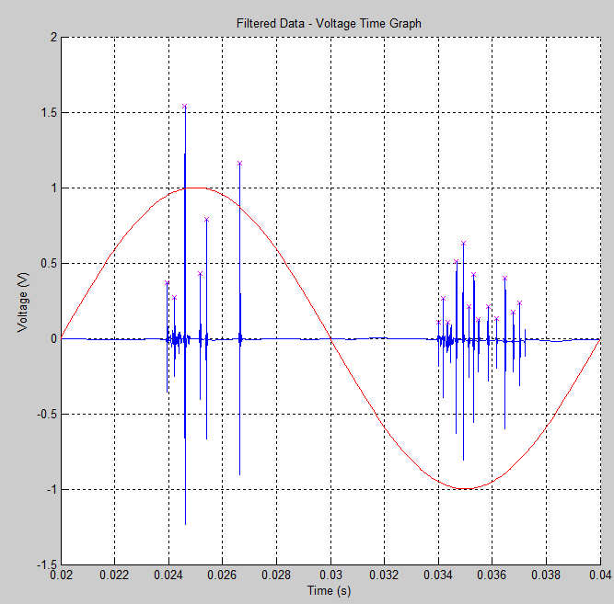
Void Detection
Notes:
The voltage change against time change graph shows a distinctive shape presenting the PDs

Slide 34
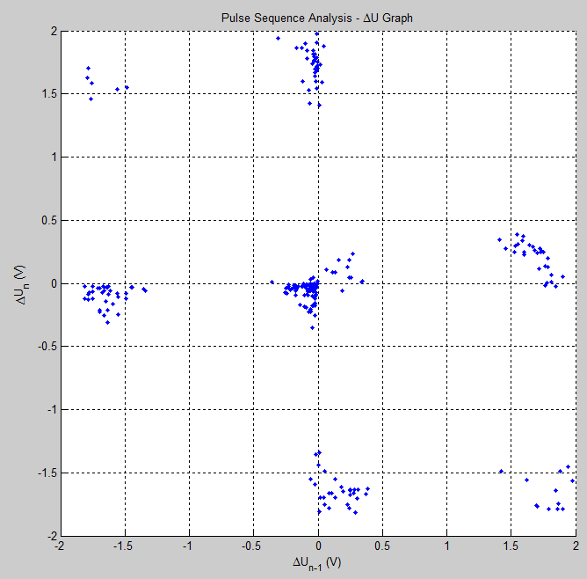
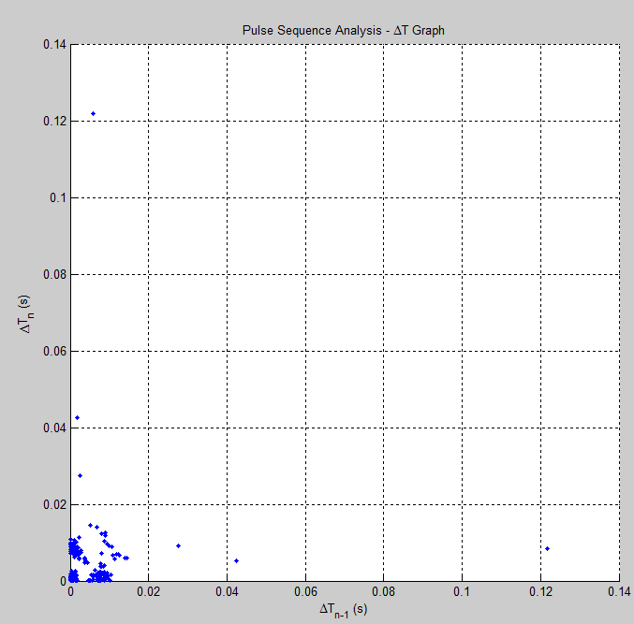
Surface Detection
Notes:
For the surface similar voltage and time graph exists, but more discharges are happening in proximity of each other.

Slide 35
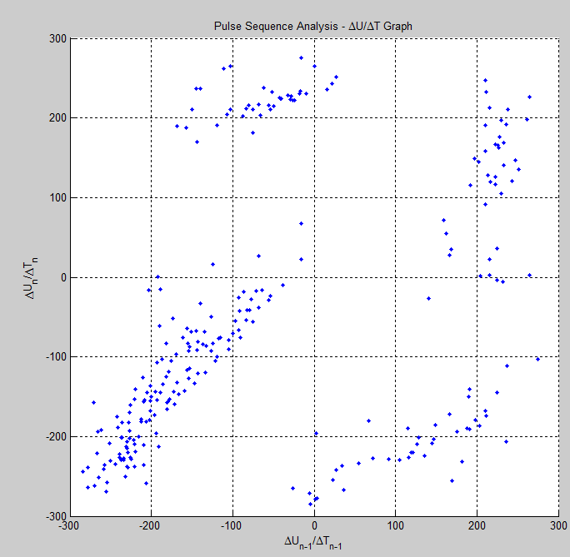
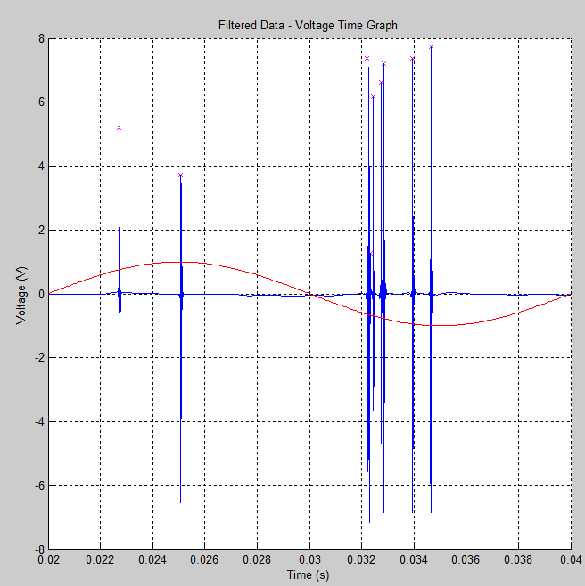
Surface Detection
Notes:
In case of surface PD the number of discharge in negative cycle is more.
because Discharge is one side bounded by metal so it will have more electron mobility on the surface on negative cycle.

Slide 36
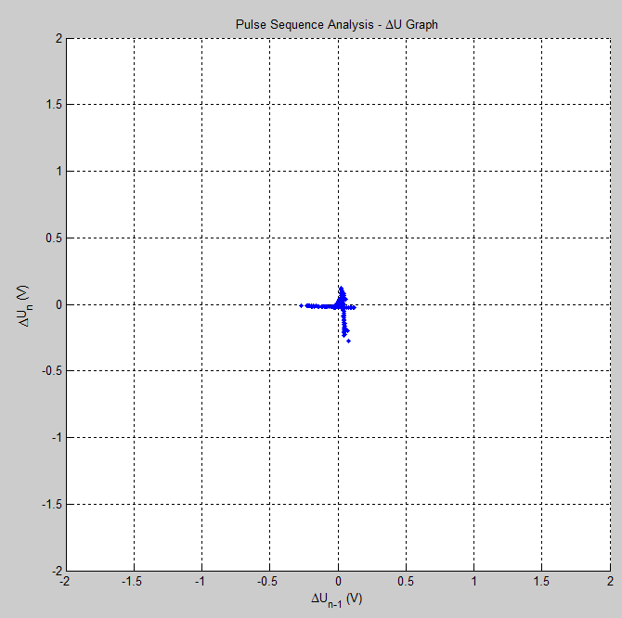
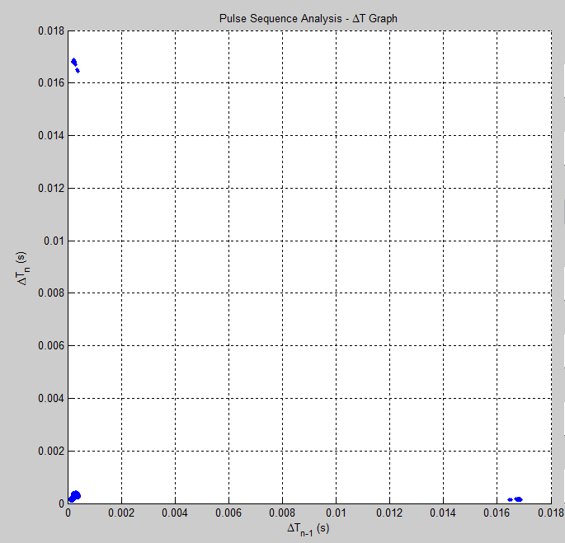
Corona Detection
Notes:
In case of corona the PDs are happening in negative cycle more often. This is because there are more availability of electron at conductor in negative cycle.
As a result the voltage difference graph shows more concentrated close to zero.

Slide 37
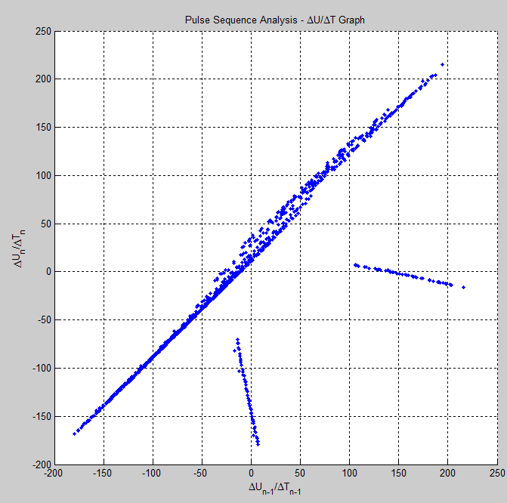
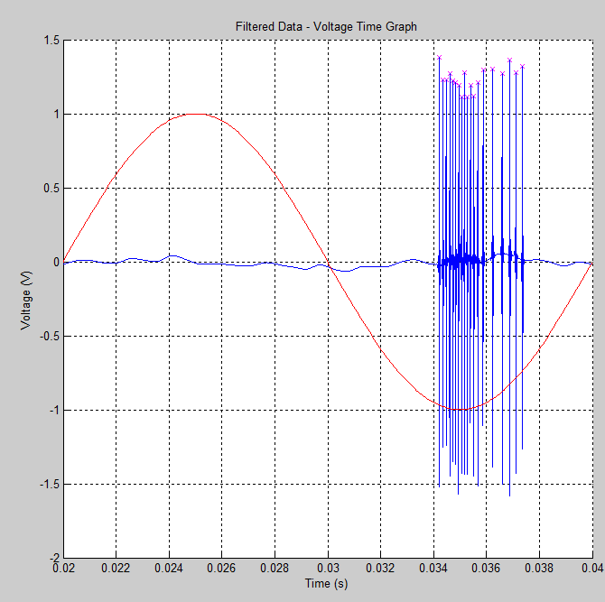
Corona Detection
Notes:
This graph show the distinct characteristic of Corona discharge.

Slide 38
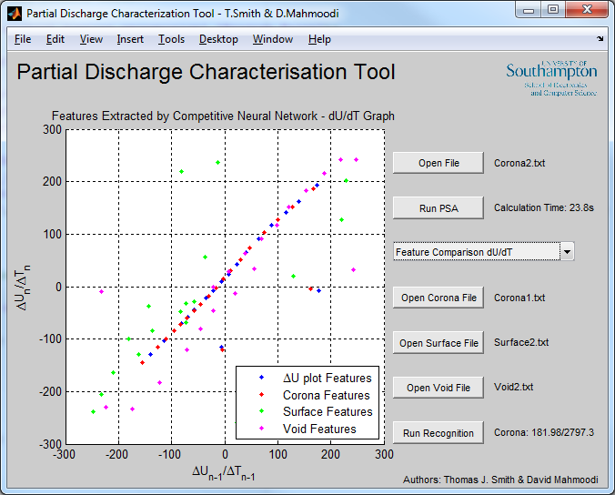
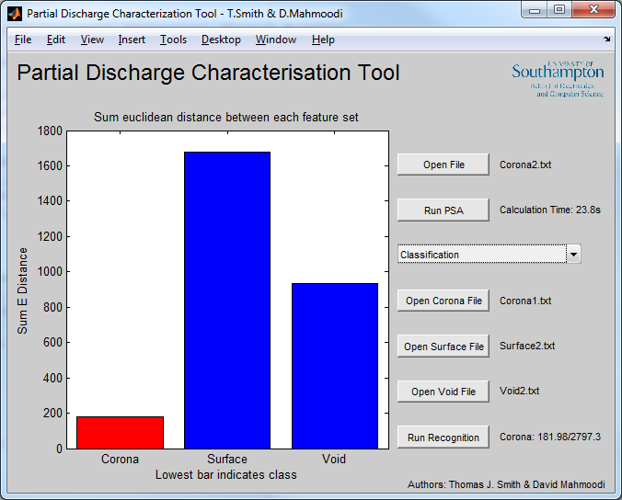
Classification
Passed testing of all 6 vectors in all combinations
Not a significant set of test data set
~30s computation time required
Notes:
Here is a sample of auto detection we carried out before. Which shows successful PD source detection
Can be classified in ~16s with i5-2500k @ 4GHz

Slide 39
Blind Test
Notes:
Perform the blind test!

Slide 40
Conclusions
PSA is an advanced technique with a real practical value when applied
Reliable, efficient & professional program
Simple method of automated classification
Extension to other discharge types
Library of precompiled reference sets
Notes:
Overall our program achieves the specification for the coursework and utilizes some advanced filtering techniques. Our additional characterization algorithm offers reliable automated recognition which surpasses the specification and makes this project a first class effort.
Further work:
Extension to recognize further PD types (streamers and tree types)
Automated database to speed up processing and increase reliability of automated characterization.

Slide 41
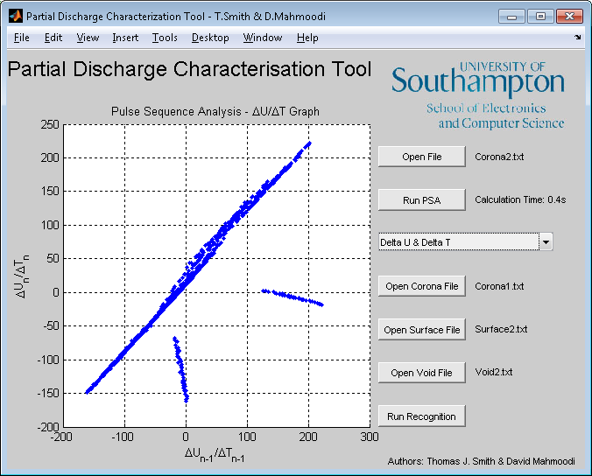
Thank you for listening
Questions?

Slide 42
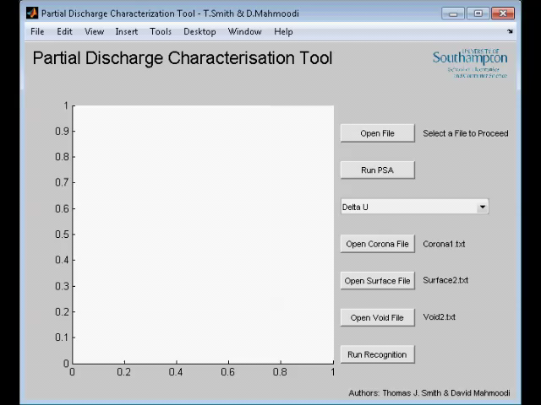
Video Demonstration
Notes:
Just in case machine doesn’t work with MATLAB or for a reminder during marking of the presentation.

